Slide 1
I/O Management Session 9
Course : COMP6153
Effective Period : September 2018

Slide 2
Sub Topics
I/O Devices
Design Issues
Disk Management
RAID configuration
Disk Arm Scheduling

Slide 3
These slides have been adapted from: Stallings, W. (2011). Operating Systems: Internals and Design Principles. 8^{th.} ISBN: 978-0-13-380591-8 Chapter 11
Acknowledgement

Slide 4
Learning Objectives
LO 2: Discuss the organization of the I/O function.
LO 2: Explain some of the key issues in the design of OS support for I/O.
LO3 Analyze the performance implications of various I/O buffering alternatives.
LO3 Understand the performance issues involved in magnetic disk access.

Slide 5
I/O Devices
Major differences
Data Rate : each devices has different data rate
Application : The use to which a device is put has an influence on the software and policies in the OS and supporting utilities
Complexity of control :complexity of the I/O module that controls the
device,

Slide 6
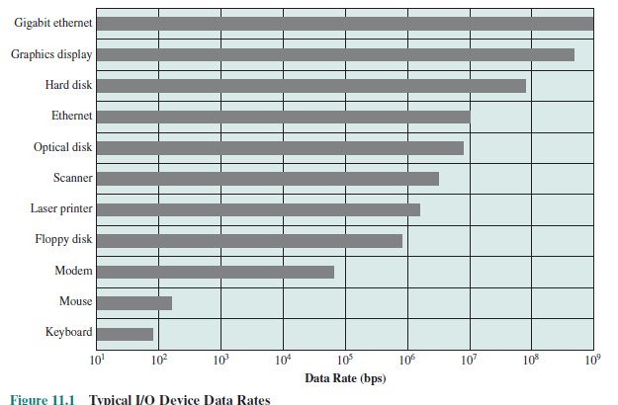
Data Rate

Slide 7
I/O Techniques
Programmed I/O
The processor issues an I/O command, on behalf of a process, to an I/O module; that process then busy waits for the operation to be completed before proceeding
Interrupt Driven I/O
The processor issues an I/O command on behalf of a process.
Direct Memory Access
A DMA module controls the exchange of data between main memory and an I/O module

Slide 8
How DMA works
When the processor wishes to read or write a block of data, it issues a command to the DMA module by sending to the DMA module the following information:
Whether a read or write is requested, using the read or write control line between the processor and the DMA module
The address of the I/O device involved, communicated on the data lines
The starting location in memory to read from or write to, communicated on the data lines and stored by the DMA module in its address register
The number of words to be read or written, again communicated via the data lines and stored in the data count register
The processor then continues with other work

Slide 9
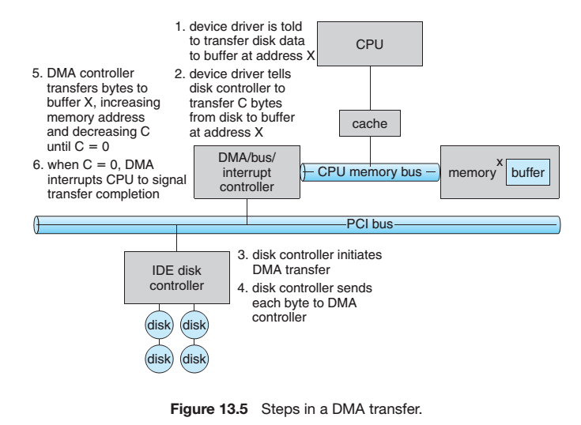
How DMA works
Silberschatz, Galvin and Gagne: Operating System Concepts

Slide 10
Hardware Issues
Efficiency - because I/O operations often form a bottleneck in a computing system
Generality - simplicity and freedom from error
- handle all devices in a uniform manner

Slide 11
O/S Issues
Efficiency
Most I/O devices extremely slow compared to main memory
Use of multiprogramming allows for some processes to be waiting on I/O while another process executes
I/O cannot keep up with processor speed
Swapping is used to bring in additional Ready processes which is an I/O operation
Generality
Desirable to handle all I/O devices in a uniform manner
Hide most of the details of device I/O in lower-level routines so that processes and upper levels see devices in general terms such as read, write, open, close, lock, unlock

Slide 12
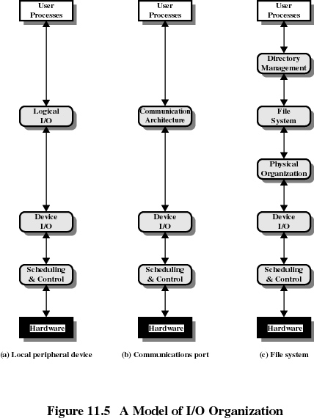
I/O Organization

Slide 13
I/O Organization
Logical I/O
The logical I/O module deals with the device as a logical resource and is not concerned with the details of actually controlling the device.
concerned with managing general I/O functions on behalf of user processes, allowing them to deal with the device in terms of a device
Device I/O
The requested operations and data (buffered characters, records, etc.) are converted into appropriate sequences of I/O instructions, channel commands, and controller orders.
Buffering techniques may be used to improve utilization.
Scheduling and control
The actual queueing and scheduling of I/O operations
occurs at this layer, as well as the control of the operations.

Slide 14
I/O Buffering (1)
Reasons for buffering
Processes must wait for I/O to complete before proceeding
Certain pages must remain in main memory during I/O

Slide 15
I/O Buffering(2)
Block-oriented
Information is stored in fixed sized blocks
Transfers are made a block at a time
Used for disks and tapes
Stream-oriented
Transfer information as a stream of bytes
Used for terminals, printers, communication ports, mouse, and most other devices that are not secondary storage

Slide 16
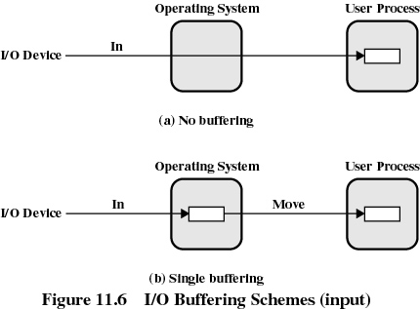
I/O Buffering(3)

Slide 17
Single Buffer
Operating system assigns a buffer in main memory for an I/O request
Block-oriented
Input transfers made to buffer
Block moved to user space when needed
Another block is moved into the buffer
Read ahead

Slide 18
Double Buffer
Use two system buffers instead of one
A process can transfer data to or from one buffer while the operating system empties or fills the other buffer

Slide 19
Circular Buffer
More than two buffers are used
Each individual buffer is one unit in a circular buffer
Used when I/O operation must keep up with process

Slide 20
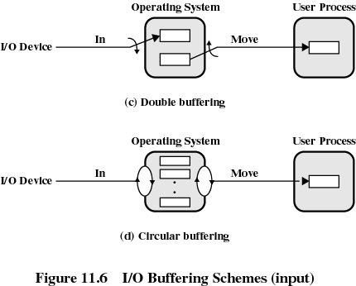
Buffering Example

Slide 21
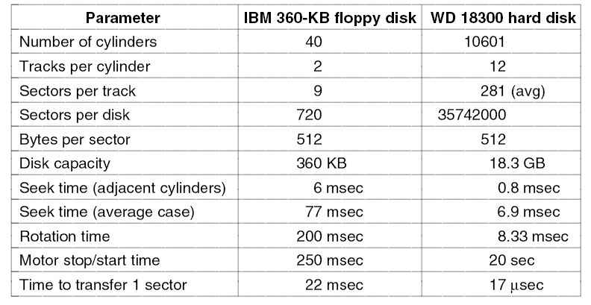
Managing Disks(1)

Slide 22
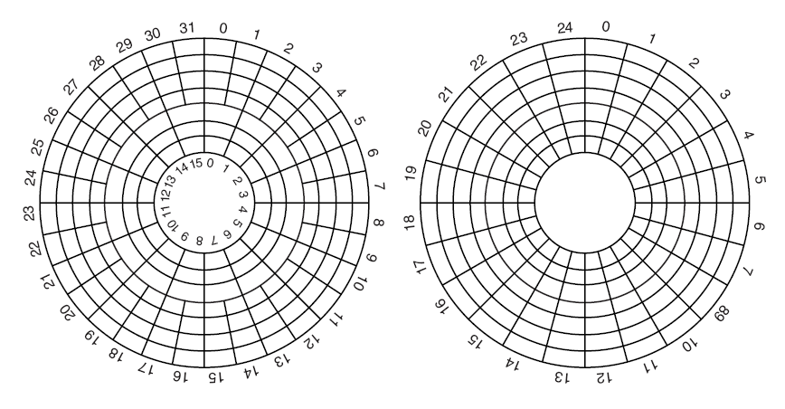
Magnetic Disks(2)
(a) Physical geometry of a disk with two zones. (b) A possible virtual geometry for this disk.

Slide 23
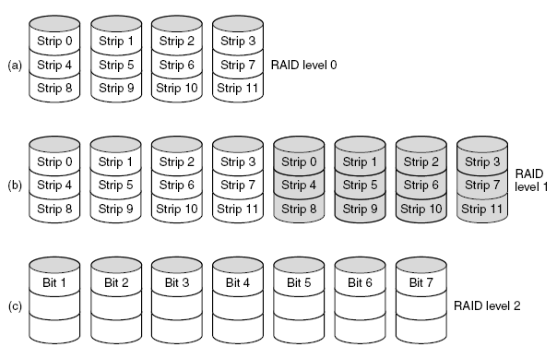
RAID(1)

Slide 24
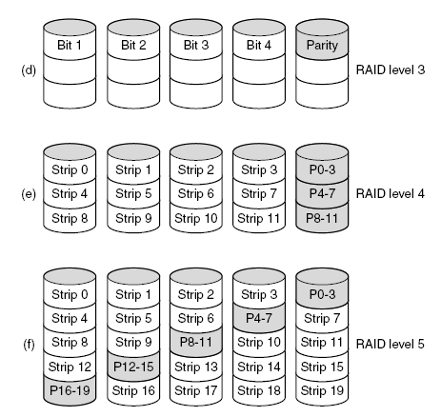
RAID(2)

Slide 25
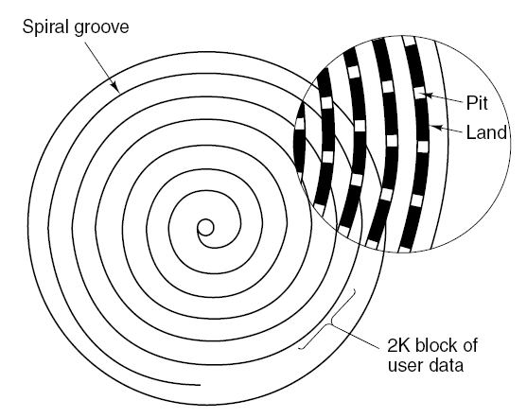
CD-ROM(1)

Slide 26
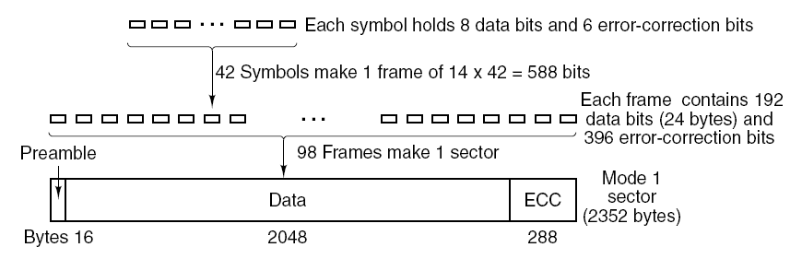
CD-ROM(2)
Logical data layout on a CD-ROM.

Slide 27
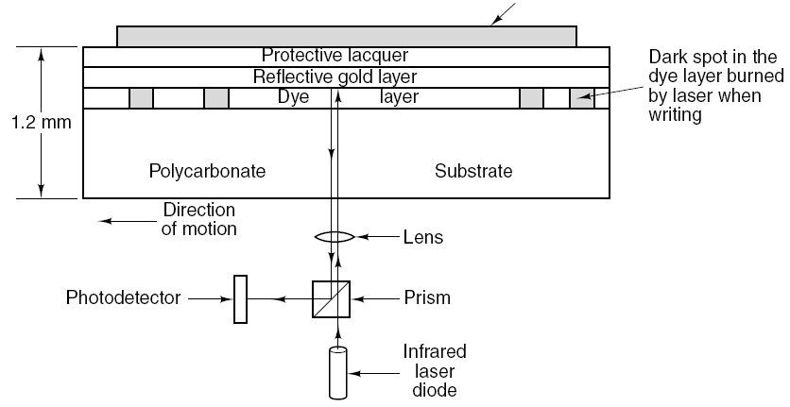
CD-Recordable
Cross section of a CD-R disk and laser. A silver CD-ROM has similar structure, except without dye layer and with pitted aluminum layer instead of gold layer.

Slide 28
DVD
DVD Improvements on CDs
Smaller pits (0.4 microns versus 0.8 microns for CDs).
A tighter spiral (0.74 microns between tracks versus 1.6 microns for CDs).
A red laser (at 0.65 microns versus 0.78 microns for CDs).

Slide 29
DVD Formats
Single-sided, single-layer (4.7 GB).
Single-sided, dual-layer (8.5 GB).
Double-sided, single-layer (9.4 GB).
Double-sided, dual-layer (17 GB).

Slide 30
Disk Formatting(1)
A disk sector.

Slide 31
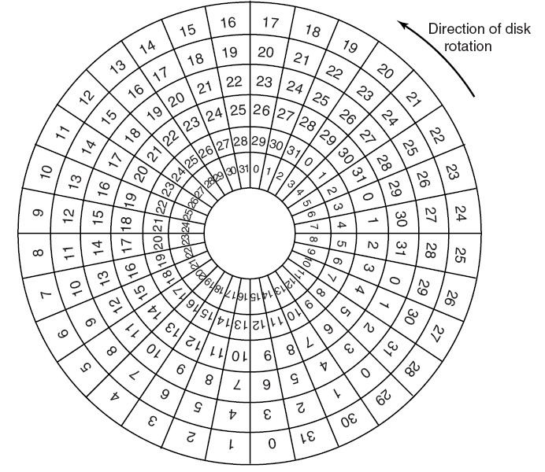
Disk

Slide 32
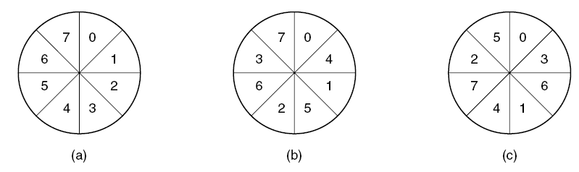
Disk Formatting
(a) No interleaving. (b) Single interleaving. (c) Double interleaving.

Slide 33
Disk Arm Scheduling
Read/write time factors
Seek time (the time to move the arm to the proper cylinder).
Rotational delay (the time for the proper sector to rotate under the head).
Actual data transfer time.

Slide 34
Disk Scheduling
FIFO
Priority
Shortest Service Time First
Scan
C-Scan

Slide 35
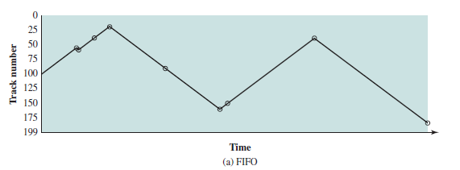
Example of Disk Scheduling(1)
assume a disk with 200 tracks and that the disk request queue has random requests in it. The requested tracks, in the order received by the disk scheduler,
are 55, 58, 39, 18, 90, 160, 150, 38, 184.

Slide 36
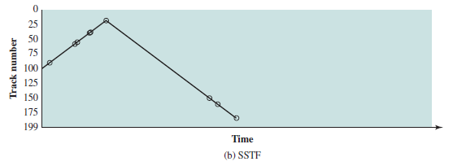
Example of Disk Scheduling(2)

Slide 37
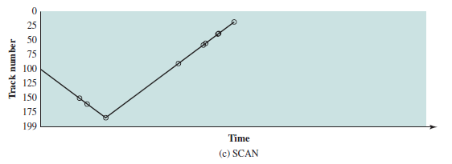
Example of Disk Scheduling(3)

Slide 38
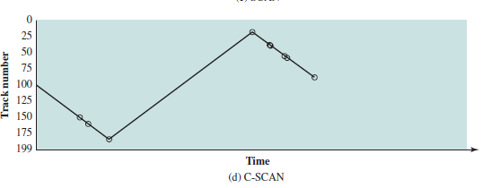
Example of Disk Scheduling(4)

Slide 39
References
Stallings, W. (2014). Operating Systems: Internals and Design Principles. 8^{th.} ISBN: 978-0-13-380591-8

